Slide 1
Web Scraping and You: Obtaining Publicly-available Data in a Consistent and High-throughput Manner
Charlie Lowe, Ph.D.

Slide 3



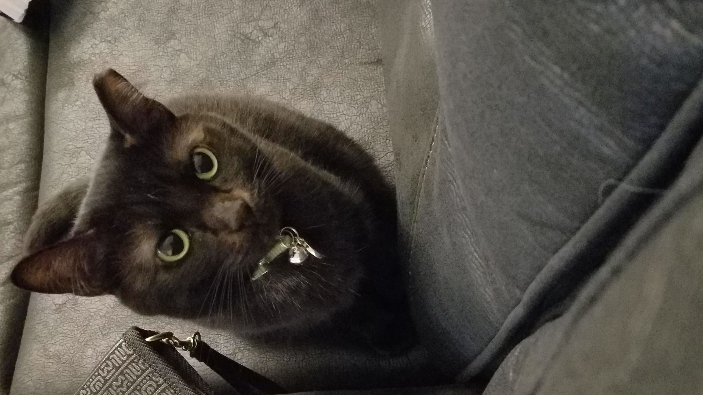
Disclosures: Nico
Please excuse any cat interruptions of this presentation

Slide 4

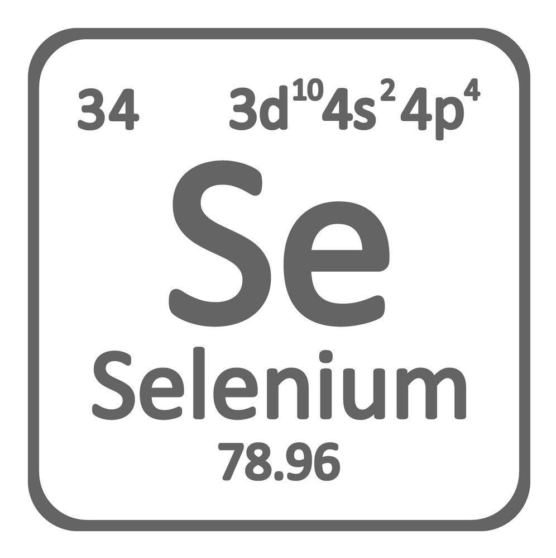


Slide 5
Why do I want/need this? What do I need?
Why would I need this?
Not everything on the world wide web is researcher friendly
Huge tables of data, spread across numerous pages
The site owner refuses to send a .csv file
You can scrape the information before the person replies…
Awesome. How much? What do I need?
It’s free!
R Studio or Python
Packages or libraries from CRAN/Github/Python download place
A STABLE internet connection

Slide 6
Use Examples
ENTACT collaborator sent ChemSpider IDs as chemical identifiers (no CASRN, InChIKey, etc)
Obtained chemical identifiers by looping over CSID list, hitting ChemSpider each time
Cannabinoid data to support current/future NTA work
100s of compound entries on sites like Forendex, isomerdesign, etc. not currently registered on Dashboard
Azo dyes aggregation to support a list of aromatic amines
1000s of compounds available, as harvested from numerous manufacturers

Slide 7
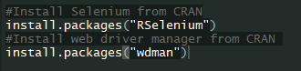
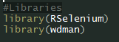
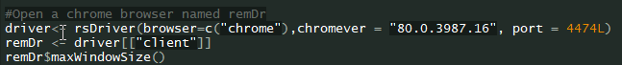
Package Installation, Loading, and Browsing

Slide 8

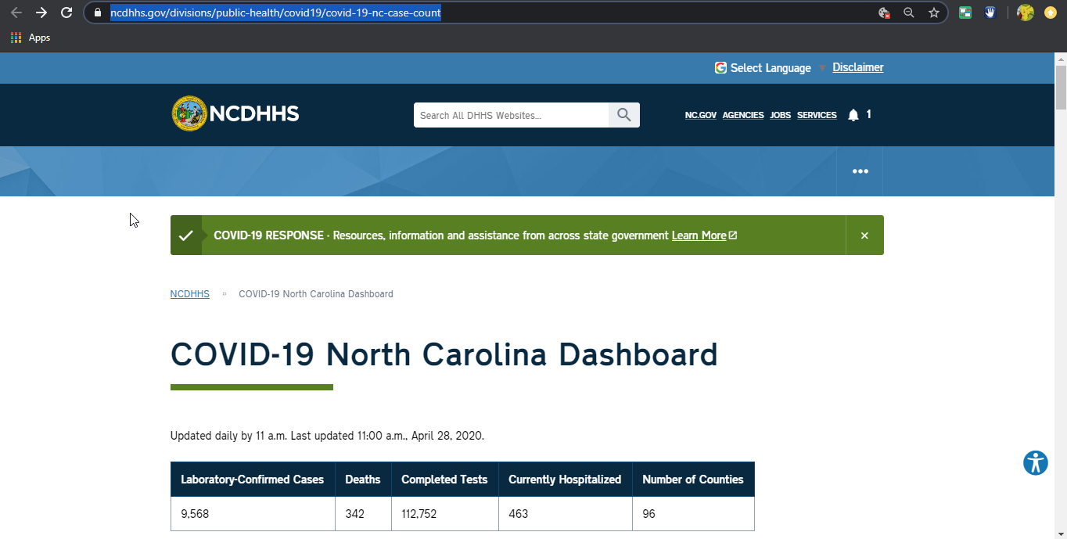
Current Events

Slide 9

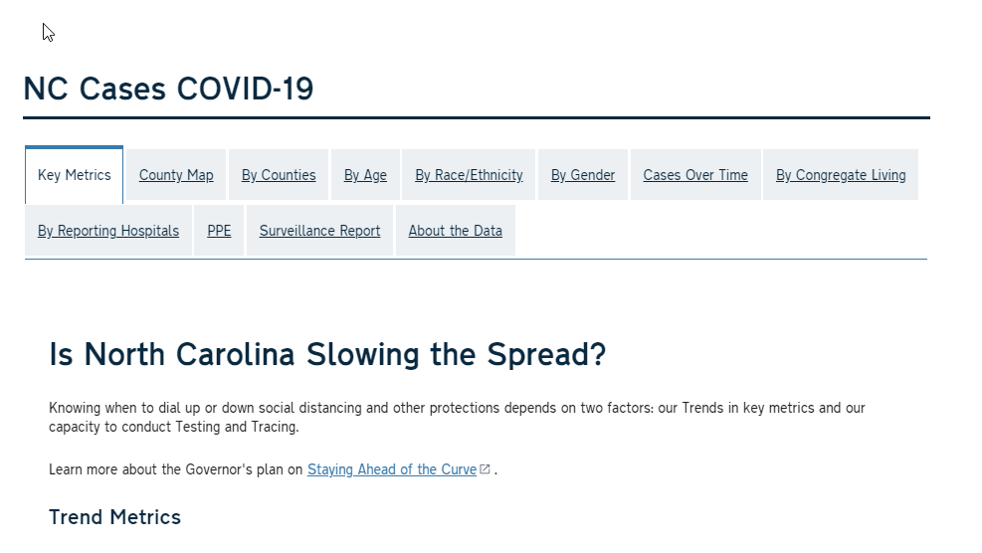
Current Events

Slide 10
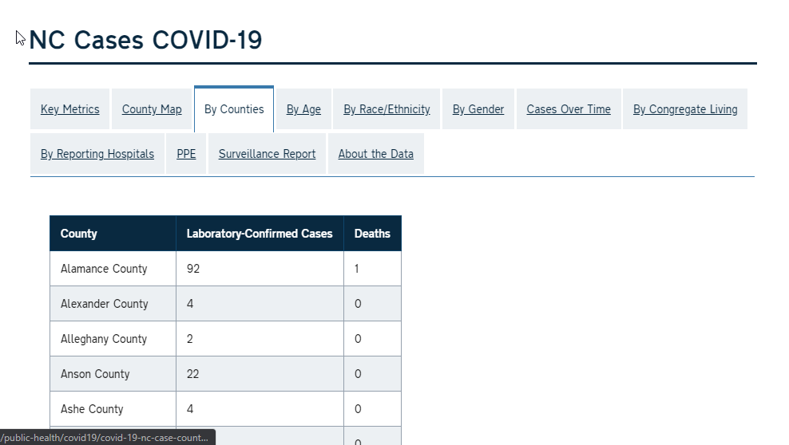
Current Events

Slide 11
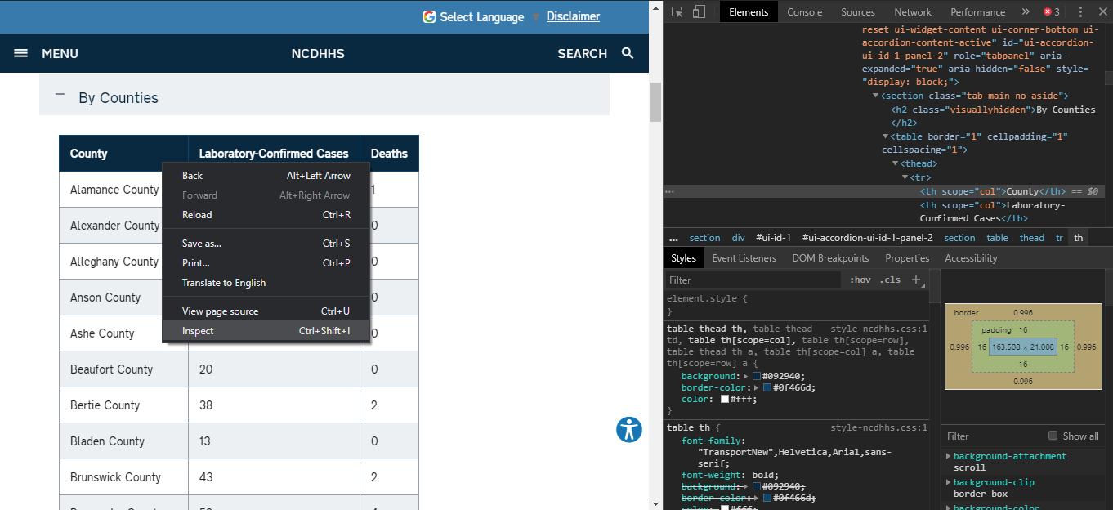
Current Events

Slide 12

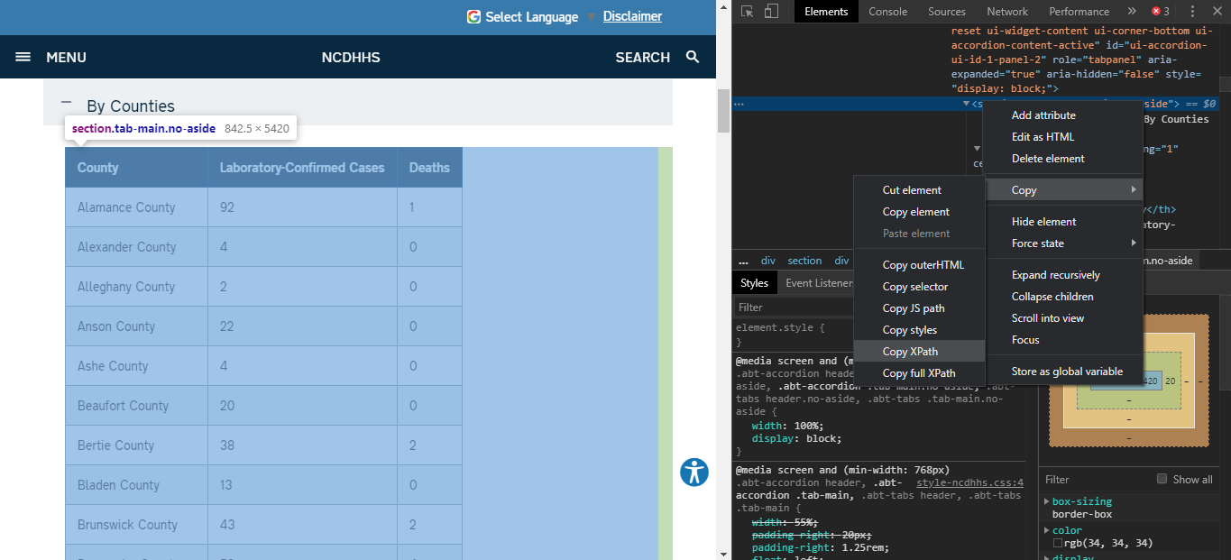
Current Events

Slide 13
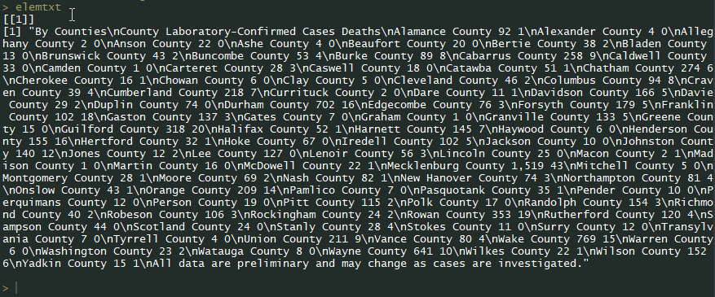
Current Events

Slide 14

Current Events

Slide 15
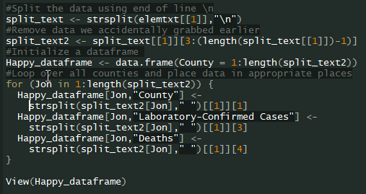

Current Events

Slide 16
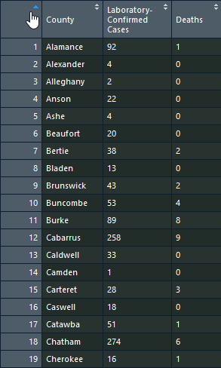
Current Events

Slide 17
Conclusions and Concerns
This allows you to get information from the web and avoid carpal tunnel
Especially useful where data is spread across many URLs
Sleep before moving between pages! You WILL be IP blocked!
Sys.sleep(sample(2:4,1))
Is this legal? Will the site owner be angry with me?
Look at the robots.txt for the website before scraping LINK
Case law seems to think so LINK
DO NOT COPY AND PASTE TO YOUR OWN WEBSITE!
Treat the information you scrape the same as information you acquire from a textbook.

Slide 18
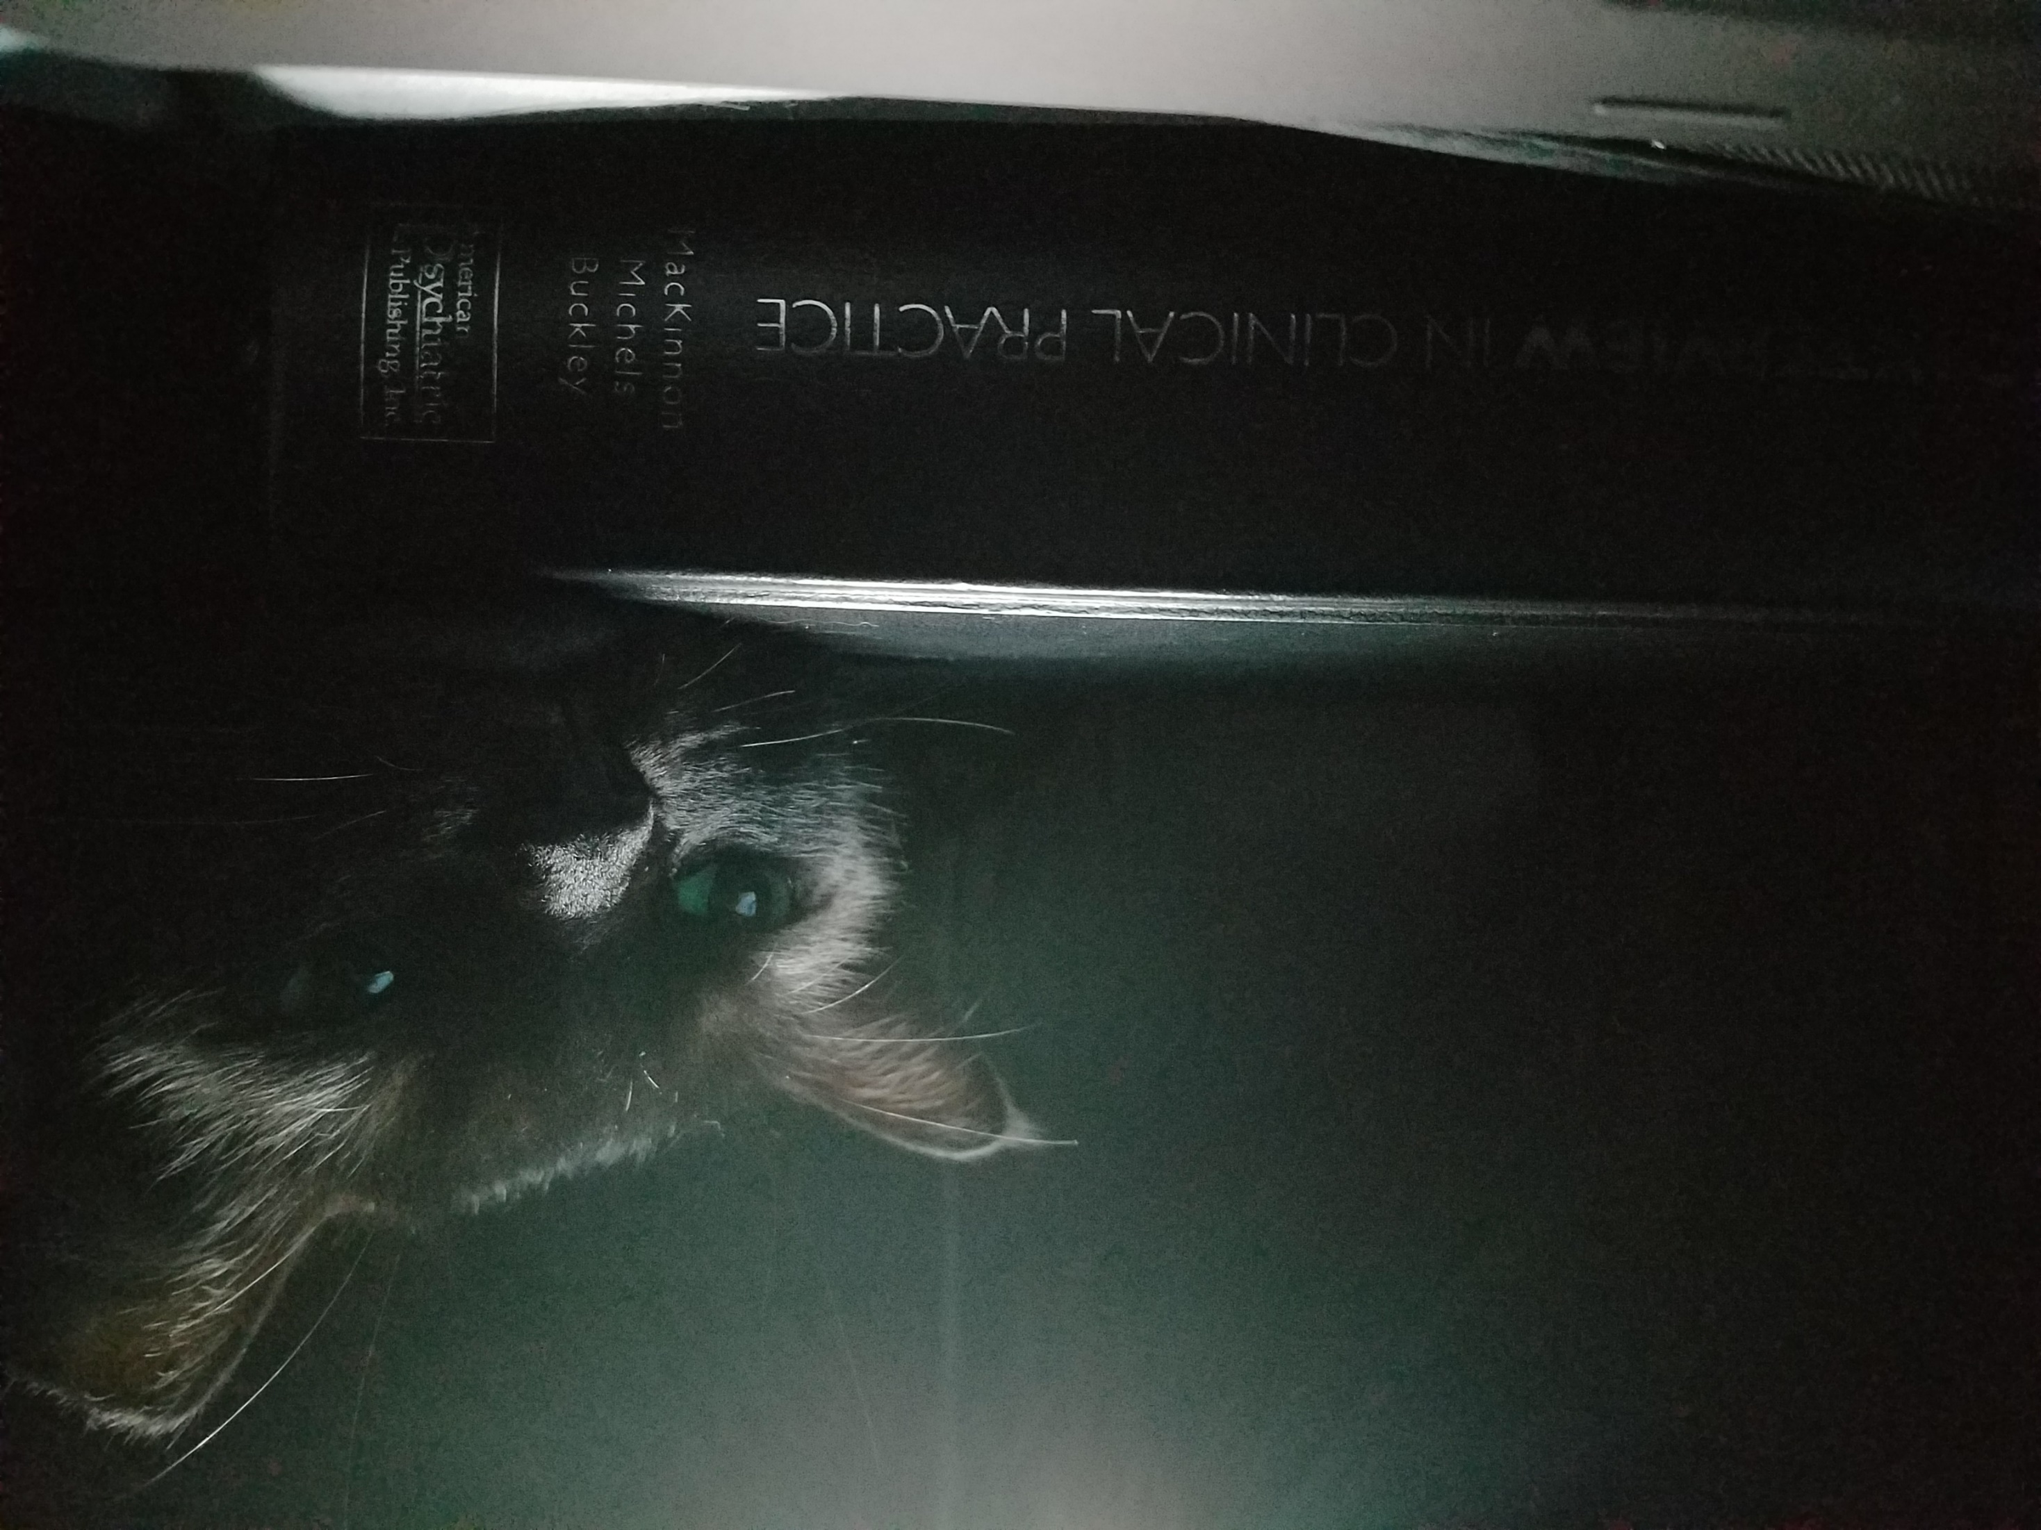
Questions?

